Slide 1

Stand der Dinge
Von Niklas und Pauls Projekt

Slide 2
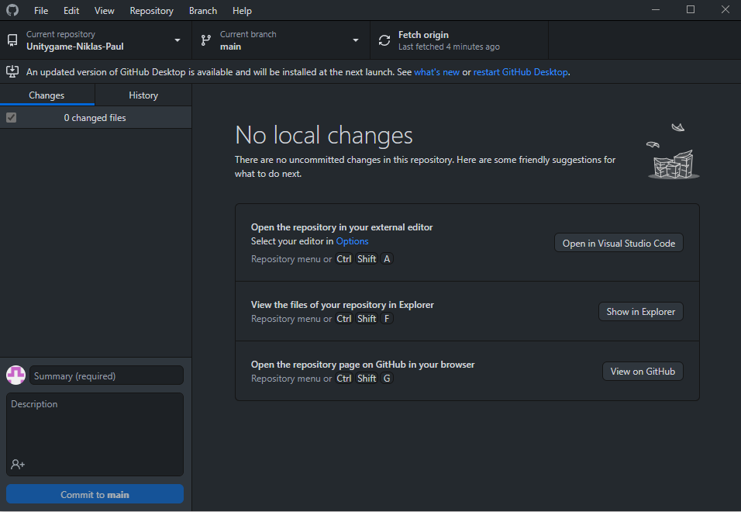
Projekt Idee:
Andere To Do‘s:
2d
Jump & Run
Mehrere Level
Pixel Grafik
Bot Gegner
GitHub
Roadmap

Slide 3
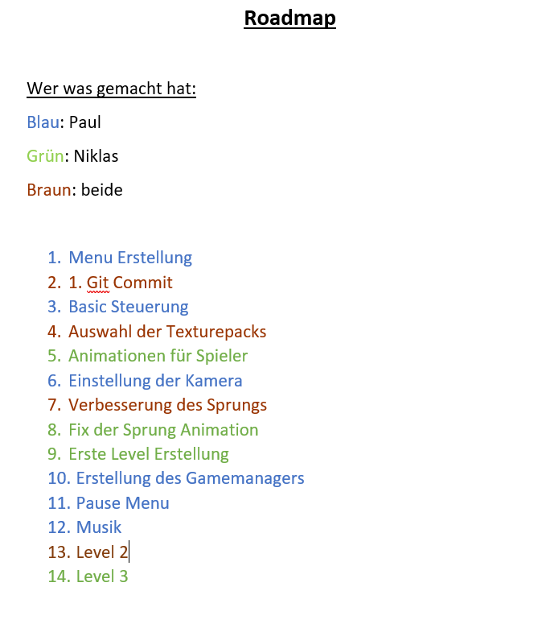
Projekt Idee:
Andere To Do‘s:
2d
Jump & Run
Mehrere Level
Pixel Grafik
Bot Gegner
GitHub
Roadmap

Slide 4



Unsere Tools:

Slide 5
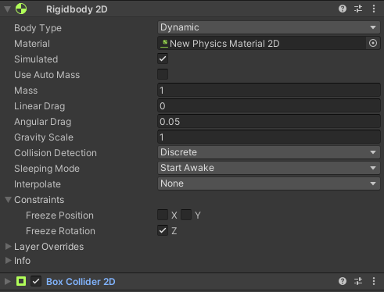

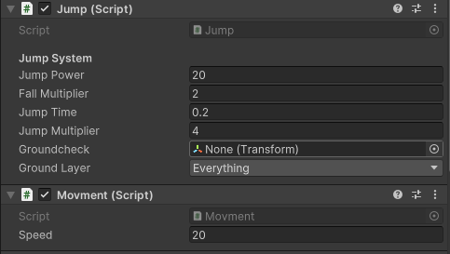
Steuerung
Unity Physics System
Movement Scripts

Slide 6
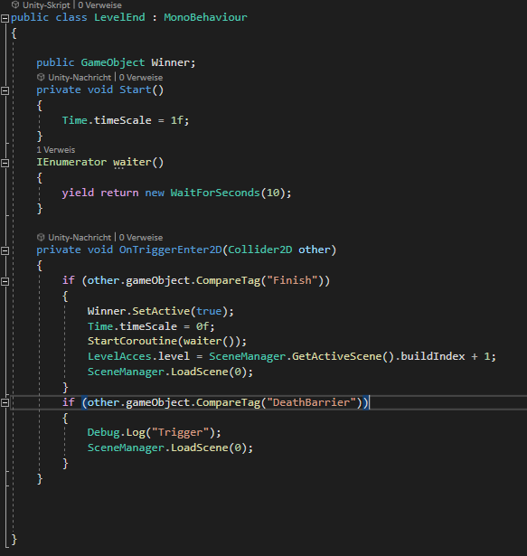
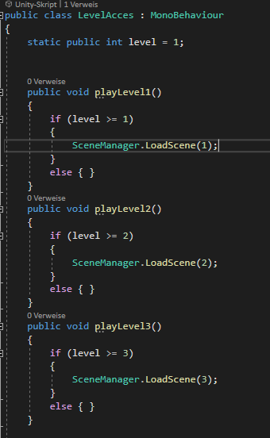
Level Management
https://www.youtube.com/watch?v=xHargJbONls

Slide 7
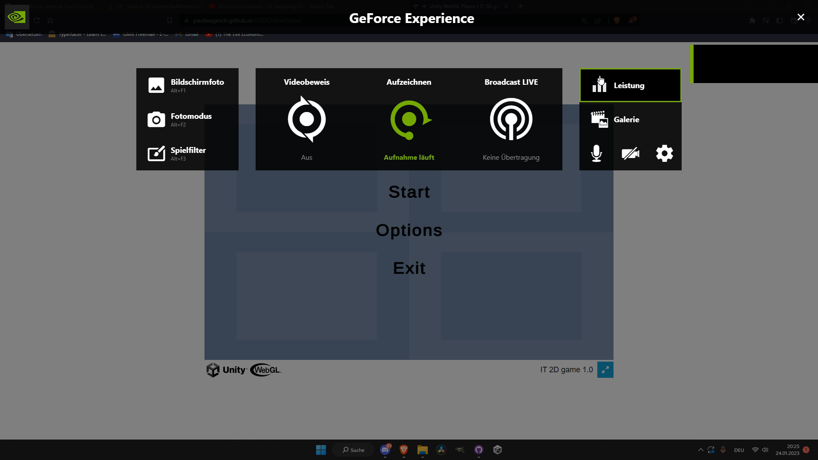

Slide 8
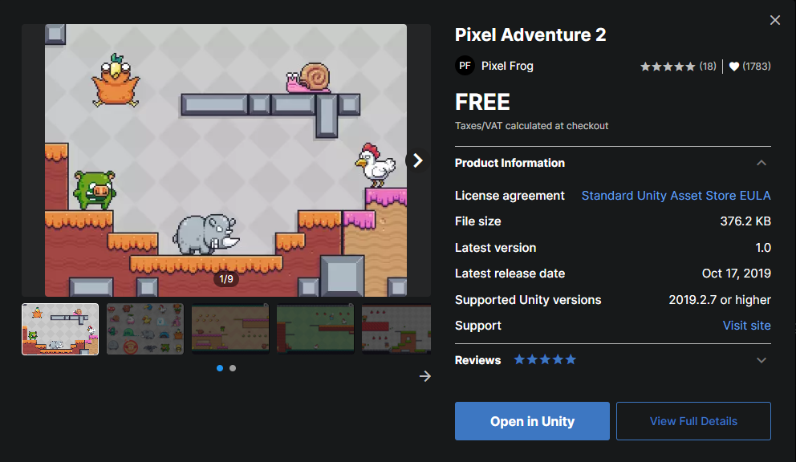
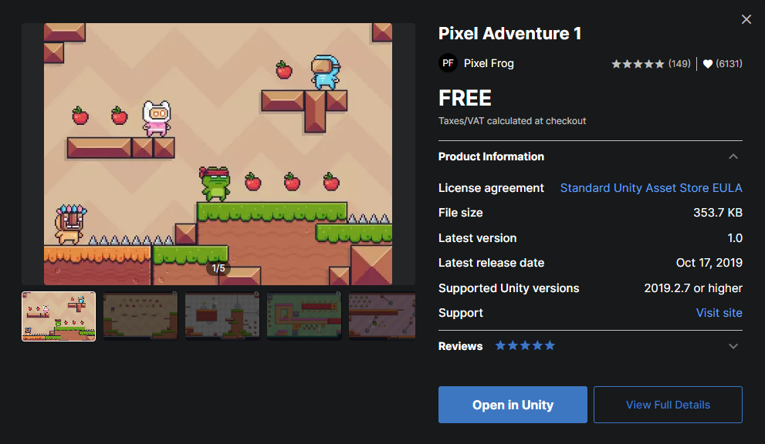
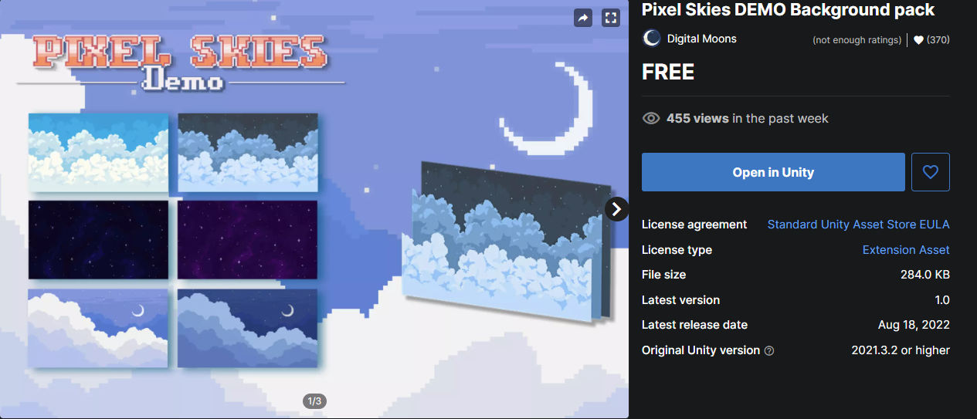
Sonstiges
Kamera:
Virtual Camera Extension
Texture Pack:
Unity Asset Store

Slide 9
Zukunftsplan
Gegner
Coin System
Mehr Level
Double/Wall Jump
Zeit System
Spiel Name

Slide 10
Links:
Bilder:
https://play.google.com/store/apps/details?id=com.github.android&hl=en_US&gl=US&pli=1 (GitHub Logo)
https://licendi.com/de/blog/tipps-fuer-microsoft-visual-studio/ (VS Logo)
https://de.wikipedia.org/wiki/Unity_%28Spiel-Engine%29 (Unity Logo)
Assets
https://assetstore.unity.com/packages/2d/characters/pixel-adventure-1-155360 (Pixel Adventure 1)
https://assetstore.unity.com/packages/2d/characters/pixel-adventure-2-155418 (Pixel Adventure 2)
https://assetstore.unity.com/packages/2d/environments/pixel-skies-demo-background-pack-226622 (Pixel Skies Demo)

